Slide 1
Chapter 4 (Part 1): Test Dimensionality

Slide 2
Test Dimensionality (1 of 10)
Hypothetical personality test:
  Talkative
  Assertive
  Imaginative
  Creative
  Outgoing
  Intellectual
What are we measuring?
  6 facets of personality?
  A single personality construct?
  Two or three separate dimensions?
Notes:
Representation of a single attribute:
The “score” from the bathroom scale must reflect only one physical dimension.
Similarly, the score obtained from a psychological test should represent only a single psychological feature or attribute.
The general rule:
Generally, though not always, to measure physical and psychological attributes, only a single attribute of the object or person is intended to be measured.
For instance, to measure social anxiety, the scores obtained should be affected only by social anxiety and not any other psychological attributes.
Combining scores:
Combining scores that are totally unrelated to each other yield no clear interpretation.
In other words, combining test scores of two independent physical or psychological scores gives no clear meaning.
Composite scores:
Some psychological tests include multiple questions or test items.
In such tests, the item responses are combined to reflect the psychological attribute(s) of interest—such scores are referred to as composite scores.
Composite scores ideally reflect only one dimension.
However, when the tests reflect more than one dimension, it leads to three important questions about the usage of these tests.

Slide 3
Test Dimensionality (2 of 10)
Dimensionality == Representation of a single attribute.
The general rule:
  Only one thing should be measured!
  Example: If measuring social anxiety, scores should only be affected by social anxiety!
Tests can have multiple dimensions
  dimensions should be treated separately!
Notes:
Representation of a single attribute:
The “score” from the bathroom scale must reflect only one physical dimension.
Similarly, the score obtained from a psychological test should represent only a single psychological feature or attribute.
The general rule:
Generally, though not always, to measure physical and psychological attributes, only a single attribute of the object or person is intended to be measured.
For instance, to measure social anxiety, the scores obtained should be affected only by social anxiety and not any other psychological attributes.
Combining scores:
Combining scores that are totally unrelated to each other yield no clear interpretation.
In other words, combining test scores of two independent physical or psychological scores gives no clear meaning.
Composite scores:
Some psychological tests include multiple questions or test items.
In such tests, the item responses are combined to reflect the psychological attribute(s) of interest—such scores are referred to as composite scores.
Composite scores ideally reflect only one dimension.
However, when the tests reflect more than one dimension, it leads to three important questions about the usage of these tests.

Slide 4
Test Dimensionality (3 of 10)
Composite Scores
  When to combine scores?
    Related ☺
    Unrelated ☹
  Why??
    If scores are independent, the combined scores are meaningless
Notes:
Representation of a single attribute:
The “score” from the bathroom scale must reflect only one physical dimension.
Similarly, the score obtained from a psychological test should represent only a single psychological feature or attribute.
The general rule:
Generally, though not always, to measure physical and psychological attributes, only a single attribute of the object or person is intended to be measured.
For instance, to measure social anxiety, the scores obtained should be affected only by social anxiety and not any other psychological attributes.
Combining scores:
Combining scores that are totally unrelated to each other yield no clear interpretation.
In other words, combining test scores of two independent physical or psychological scores gives no clear meaning.
Composite scores:
Some psychological tests include multiple questions or test items.
In such tests, the item responses are combined to reflect the psychological attribute(s) of interest—such scores are referred to as composite scores.
Composite scores ideally reflect only one dimension.
However, when the tests reflect more than one dimension, it leads to three important questions about the usage of these tests.

Slide 5
Test Dimensionality (4 of 10)
Composite Scores
  Tests often measure attributes with multiple questions
  Why?
  Composite scores == combining scores for multiple items measuring the same construct
Notes:
Representation of a single attribute:
The “score” from the bathroom scale must reflect only one physical dimension.
Similarly, the score obtained from a psychological test should represent only a single psychological feature or attribute.
The general rule:
Generally, though not always, to measure physical and psychological attributes, only a single attribute of the object or person is intended to be measured.
For instance, to measure social anxiety, the scores obtained should be affected only by social anxiety and not any other psychological attributes.
Combining scores:
Combining scores that are totally unrelated to each other yield no clear interpretation.
In other words, combining test scores of two independent physical or psychological scores gives no clear meaning.
Composite scores:
Some psychological tests include multiple questions or test items.
In such tests, the item responses are combined to reflect the psychological attribute(s) of interest—such scores are referred to as composite scores.
Composite scores ideally reflect only one dimension.
However, when the tests reflect more than one dimension, it leads to three important questions about the usage of these tests.

Slide 6
Test Dimensionality (5 of 10)
What about when tests have multiple dimensions?
  Three questions to ask:
    How many dimensions are reflected in test items?
    Are the dimensions correlated?
    What attributes are the dimensions trying to assess?
Notes:
First dimensionality question:
The first important question about the dimensionality of a test is how many dimensions are reflected in the test items.
This question is important, because each dimension of a test is likely to be scored separately and with its own psychometric analysis.
Second dimensionality question:
In the case of more than one dimension, are the dimensions correlated with each other?
The correlation between the dimensions can be associated with the meaningfulness of a “total score” for a test.
Third dimensionality question:
What are the dimensions and what psychological attributes are reflected by the test dimensions?
The significance of the question is to understand the score’s psychological meaning and therefore score and interpret a dimension of a test effectively.

Slide 7
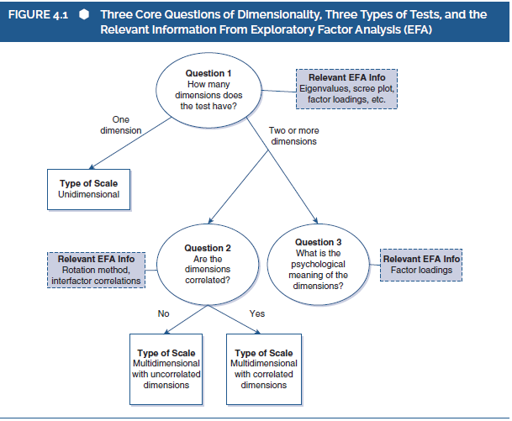
Notes:
Figure 4.1: Three core questions of dimensionality, three types of tests, and the relevant information from exploratory factor analysis (EFA).

Slide 8
Test Dimensionality (6 of 10)
Unidimensional Tests
  Any test that with items that only reflect a single attribute
Example:
  College exam scored on number of correctly answered items
  What does the test score mean?
Because the test reflects a single attribute, a single score can be evaluated
Notes:
Definition of unidimensional test: A psychological test with items that reflect only a single attribute of a person and therefore the responses to those items are driven only by that attribute, the test is referred to as unidimensional.
An example:
Consider a geometry test which is scored based on the number of questions answered right by the student.
The test score is interpreted as a measure of the amount of the student’s “knowledge of geometry” in the case the test items truly requires only the knowledge of geometry.
Such tests are considered unidimensional, and they reflect only one dimension or attribute (which is knowledge of geometry in this case).
Also, the test items possess the property of conceptual homogeneity.
Implications of the dimensionality:
Dimensionality affects the scoring, evaluation, and use of the test.
In the case of a unidimensional test, a single score is computed, reflecting the single psychological attribute measured by the test.
In psychometric evaluation, the single score obtained from the unidimensional test is evaluated.

Slide 9

Notes:
Figure 4.2: Unidimensional test.

Slide 10
Test Dimensionality (7 of 10)
Multidimensional Tests with Correlated Dimensions (Tests with Higher Order Factors)
  Example: IQ Testing
    The Stanford–Binet test (SB5).
    Five groups of questions (subsets) that measure 5 correlated dimensions
Notes:
A multidimensional test:
When a test includes items that reflect more than one attribute, the test is referred to as multidimensional.
When the different dimensions of such a test are correlated, then it becomes a multidimensional test with correlated dimensions or a test with higher order factors.
The Standard–Binet test:
The Standard–Binet or SB5 is an example of a multidimensional test with correlated dimensions.
In this test, there are five groups of questions referred to as subtests and they are correlated to each other.
Implications of test dimensions:
Just like the unidimensional test, the dimensionality of multidimensional tests with correlated dimensions affects the scoring, evaluation, and use of the test.
While a multidimensional test produces a variety of score, each subtest is unidimensional with its own subtest score and conceptually homogenous questions.
The subtest score can be used to interpret a single psychological attribute, provided the subtest is unidimensional.
Obtaining the total test score:
In a multidimensional test with correlated dimensions, subtest scores are combined with one another through multiple ways such as averaging the scores, adding the scores, and so on.
Thus, a final total test score is obtained.

Slide 11
Test Dimensionality (8 of 10)
Implications of multiple test dimensions.
  Multiple scores, think of each subscale score as a separate unidimensional score
Obtaining the total test score:
  Total score can be obtained by combining subscale scores
  Subscale scores must be correlated!
Notes:
A multidimensional test:
When a test includes items that reflect more than one attribute, the test is referred to as multidimensional.
When the different dimensions of such a test are correlated, then it becomes a multidimensional test with correlated dimensions or a test with higher order factors.
The Standard–Binet test:
The Standard–Binet or SB5 is an example of a multidimensional test with correlated dimensions.
In this test, there are five groups of questions referred to as subtests and they are correlated to each other.
Implications of test dimensions:
Just like the unidimensional test, the dimensionality of multidimensional tests with correlated dimensions affects the scoring, evaluation, and use of the test.
While a multidimensional test produces a variety of score, each subtest is unidimensional with its own subtest score and conceptually homogenous questions.
The subtest score can be used to interpret a single psychological attribute, provided the subtest is unidimensional.
Obtaining the total test score:
In a multidimensional test with correlated dimensions, subtest scores are combined with one another through multiple ways such as averaging the scores, adding the scores, and so on.
Thus, a final total test score is obtained.

Slide 12
Test Dimensionality (9 of 10)
Multidimensional Tests with Uncorrelated Dimensions
  Example: Personality testing (NEO-FFI)
  Measures five distinct dimensions of personality
    Treated as independent!
  Cannot compute a total “personality” score!
Notes:
Test with unassociated dimensions: Multidimensional tests with dimensions that are not associated with one another are considered a multidimensional test with uncorrelated dimensions.
An example:
The NEO Five Factor Inventory (NEO-FFI-3) is a personality test that reflects five independent personality attributes.
The five attributes of the test are not typically treated as reflecting any higher order factors and the test scores for each dimension is treated as if it were unidimensional.
Scoring, evaluation, and use of test:
For multidimensional tests with uncorrelated dimensions, no total test score is computed.
The test score of each dimension is evaluated in terms of psychometric quality.
Test score of each dimension after evaluation can be used by researchers and psychologists.

Slide 13

Multidimensional Tests with Correlated Dimensions.
Notes:
Figure 4.3: Multidimensional test with correlated dimensions (i.e., a higher order factor test).

Slide 14
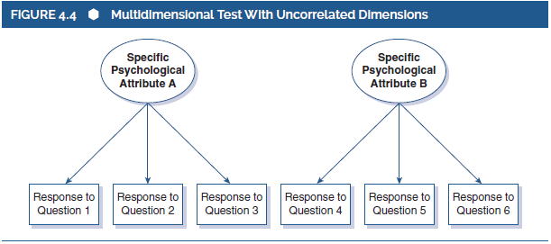
Multidimensional Tests with Uncorrelated Dimensions.
Notes:
Figure 4.4: Multidimensional test with uncorrelated dimensions.

Slide 15
Test Dimensionality (10 of 10)
What about the Psychological Meaning of Test Dimensions?
  Important because it helps us interpret scores
  What does it mean to have an IQ of 100? Or a conscientiousness score of 3.5?
Factor analysis
  Statistical tool for evaluating test dimensionality (More on that later!)
Notes:
Third important dimensionality issue.
When the dimensionality issue and association between multiple dimensions are addressed, the third issue in hand is to understand the psychological meaning of each test dimension.
This is important because revealing the psychological attribute of each test dimension allows accurate interpretation and use of test’s dimensions.
Factor analysis: Factor analysis is a statistical tool used to evaluate test dimensionality.

Slide 16
Questions so far?
Notes:
Third important dimensionality issue.
When the dimensionality issue and association between multiple dimensions are addressed, the third issue in hand is to understand the psychological meaning of each test dimension.
This is important because revealing the psychological attribute of each test dimension allows accurate interpretation and use of test’s dimensions.
Factor analysis: Factor analysis is a statistical tool used to evaluate test dimensionality.

Slide 17
Reminders! (1 of 2)
Psychometric Project:
  Due 10/10 @ 11:59
  Pick a construct
    3 subscales (each measuring 1 dimension of your construct)
    Each subscale needs to have at least 6 items
    Template questionnaire on D2L!

Slide 18
Reminders! (2 of 2)
Exam 1 in Class Thursday (9/21)
Meet in PY101, NOT computer lab
Exam Review

